Slide 1
IT Basics 1
Faculty of Cybernetics, Statistics and Economic Informatics –
BUES
Prof. Răzvan ZOTA, Ph.D.
zota@ase.ro
https://zota.ase.ro/itb

Slide 2
Contents
1. Introduction. Short computer history. The basic architecture of a PC. 2. Information theory 3. Numbering basis for a computer 4. Digital logic basics for a computer 5. The microprocessor (+ ASM - lab) 6. Memory and system buses 7. Computer peripherals 8. Storage devices 9. Computer networks (a –short- introduction)

Slide 3
Bibliography
1. Bazele Tehnologiei Informaţiei, Floarea Năstase, Răzvan Zota, Ed. InfoMega, 2007. 2. Bazele Tehnologiei Informaţiei, Floarea Năstase, Răzvan Zota, Ed. ASE, 2005. 3.Elemente de arhitectură a sistemelor de calcul şi operare, Răzvan Zota, Ed. ASE, 2004. 4. Sisteme de calcul şi operare, Floarea Năstase, Răzvan Zota, Ed. ASE, 2004

Slide 4
Laboratory contents
Labs 1-7. Applications for: - Information theory - Numbering basics - Digital logic basics Lab 8 : Test (15% of the final grade) Labs 9-12 : Intel ASM (Assembler) Lab 13-14 : Test (10%) and Project presentation (5% of the final grade)

Slide 5
Short history of the computers

Slide 6
The abacus: the first “Automatic Computer”
As we know it today, it appears (documented) for the first time around 1200 in China (suan-pan) from the need to automate the counting process

Slide 7
Pioneers - Blaise Pascal (1623-1662)
French matematician who invented the first operational computer machine
“Arithmetic Machine” – introduced in 1642
Addition and substraction
Substraction was made by using complementary techniques (similar with those used in the modern computers)
Multiplying and dividing were implemented by using multiple additions/substractions

Slide 8
Pioneers - Charles Babbage (1791-1871)
British matematician who invented the first device which can be considered a computer in the modern sense of the word
They were computed tables of logarithmic and trigonometric functions; operated by men called “computers”
“Difference Engine” (1822) – partly built
“Analytical Engine” (1830)
The “Difference Engine” was built after using the original sketches by a team at the Science Museum in London.
8000 parts
It weighs 5 tons, aprox. 3 meters in width, 2 ½ in length
The equipment had made the first calculus sequence in 1991 with a precision of 31 decimal digits

Slide 9
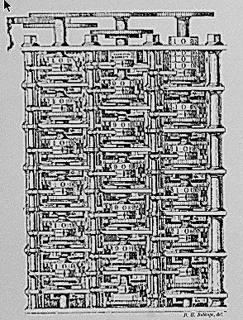
“Difference Engine”

Slide 10
Claude Shannon
Around 1850 the British mathematician George Boole have invented “The Boole Algebra”
The Boole Algebra was relatively unknown and unused till 1938
The master thesis of C. Shannon from 1938 have demonstrated how the concepts of “TRUE” and “FALSE” may be used to represent the switches functionality of the electronic circuits

Slide 11
Howard Aiken and IBM Harvard Mark I computer
Harvard Mark 1 (IBM Automatic Controlled Calculator) was built between 1939 and 1944
It was made from multiple computers working for different parts of the same problem under the supervision of a unique control unit
Built from switches, relays and other mechanical devices
It used 750.000 components and had 16 m in length, 2 ½ m high and had a weight of 5 tons
Numbers of 23 digits
A multiplication was about 4 seconds long
A division took about 10 seconds to complete

Slide 12
William Mauchly, J. Presper Eckert - ENIAC - Electronic Numerical Integrator And Computer
Was built at the University of Pennsylvania (1943-1946)
3 m high, 30 sqm area, 30 tons
18.000 vacuum tubes
150 kW of power (enough to provide the light for a small village)
The key problem with this type of computer was the reliability:
aprox. 50 tubes were replaced every day
1943 - Eckert and Mauchly had initiated the concept of creating a program stored in a computer using an internal memory (storing both instructions and data)

Slide 13
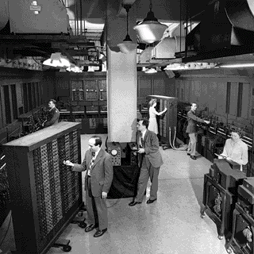
ENIAC - 1946

Slide 14
The next generations
EDVAC - Electronic Discrete Variable Automatic Computer
4000 tubes
EDSAC - Electronic Delay Storage Automatic Calculator (1949)
3000 tubes
UNIVAC I - Universal Automatic Computer (1951)
First commercial computer
ILLIAC I (1949)
Built at the Illinois University, the first computer owned by an academic institution

Slide 15
John Von Neumann
The great mathematician Von Neumann have worked as a consultant for the ENIAC and EDVAC projects
The first version of a report about EDVAC – 1945 contained the basic elements of a computer stored program:
A memory for both data and instructions
A computing unit for doing arithmetic and logical calculus of the data
A control unit which could translate an instruction from the memory and select different actions using the results of the previous operations

Slide 16
The first transistor
Bell Laboratories begun the research in the field of semiconductors in 1945
William Shockley, Walter Brattain and John Bardeen have created the first transistor on December 23rd, 1947
They took a break to celebrate the Christmas before publishing the event; this is the reason why some books indicate that the first transistor was created in 1948

Slide 17
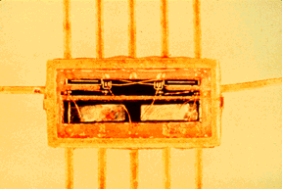
The first integrated circuit
Jack Kilby (Texas Instruments) in 1958 have succeeded to combine more components on a single piece of semiconductor
In 1961 Fairchild and Texas Instruments have developed the first commercial integrated circuits which contained basic logical functions
2 logical gates (4 bipolar transistors and 4 resistors)
In 1970 Fairchild had introduced for the first time the memory of 256 bits static RAM

Slide 18
Moore’s law
In 1964 Gordon Moore foreseen that the number of transistors of a chip will double in a time interval of aprox. 18-24 months

Slide 19
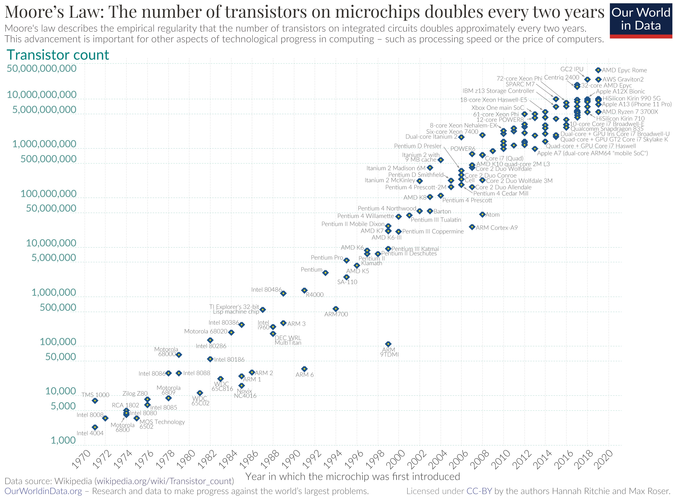

Slide 20
The path to the first personal computer (PC)
Computers are beginning to use transistors (the 60ies)
“Big iron” years: IBM mainframes
In 1970 the Japanese computer company Busicom asked Intel a set of 12 IC to use it in a new computer
T. Hoff, project engineer at Intel, inspired by this demand, have designed the first microprocessor, called 4004
2300 transistors; 60.000 operations per sec
The first general purpose microprocessor - 8080, introduced by Intel in 1974
8-bits, 4500 transistors, 200.000 operations per sec
Other processors: Motorola 6800, MOS Technology 6502, Zilog Z80

Slide 21
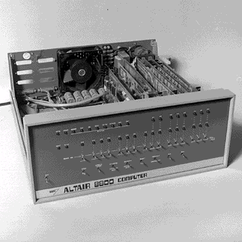
Personal computers
Ed Roberts made Altair 8800 (1974)
Based on 8080
Price of 375$
No keyboard, no screen, no storage capacity
4k memory, programmable by a central panel with switches
Bill Gates and Paul Allen are founding Microsoft (1975)
BASIC 2.0 with Altair 8800
The first high level programming language available on a PC

Slide 22
Personal computers (cont.)
S. Wozniak and S. Jobs:
Apple 1 - 1976
Apple II - 1977
16k ROM, 4k of RAM, keyboard and colour display
Price of 1300$, in 1977 business of 700.000 $ and in 1978 7 mil.
TRS-80 (based on Z80) from Radio Shack - 1977
4k ROM, 4k RAM, keyboard and tape
price 600$
The first PC (Personal Computer) from IBM - 1981
Microprocessor on 16-bits 8088, ROM BASIC, floppy-disc 360K, DOS 1.0
price1365 $

Slide 23
Personal computers (cont.)
1983 IBM XT has hard-disk (10Mb costs 3000$)
1985 Intel is introducing 80386
The first member on 32-bits in the 80x86 family
1986 Compaq is introducing the first system based on 80386
1989 Intel is introducing 80486 (with math coprocessor)
1992 Intel Pentium (64-bits) memory bus
AMD, Cyrix 486 compatible processors
1996 Intel Pentium Pro
1998 Intel Pentium II
2000 Intel Pentium IV la 1.5 GHz

Slide 24
Personal computers (cont.)
Pentium M, Celeron M – 2003
Intel Core (65nm) Duo/Solo – Jan. 2006
Dual Core Xeon – 2006
Intel Core 2 (65nm) Duo – July 2006
Intel Core i3, i5, i7 (45nm) – 2009 (Nehalem) with variants of 2,4,6,8,10,12 core (731 million transistors for quad-core)
Intel Core i3, i5, i7 – 4th generation Intel Core Processors – 2013 (Haswell arch.)

Slide 25
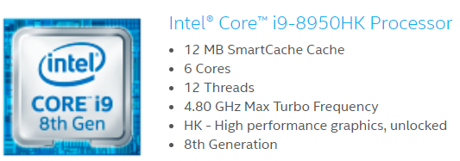
Personal computers (cont.)
Intel's 8th generation: Core i9
9th Generation from Intel: Core i9 – 8 cores, 16 MB Cache, 5 GHz Max Turbo Frequency
10th Gen Intel: Core i9 – 10 cores, 20 MB Cache
11th Generation Intel: Core i9 – 8 cores, 16 MB Cache, 5.20 GHz Max Turbo Frequency
12th and 13th Gen Intel® Core™ - up to 24 cores

Slide 26
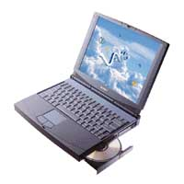
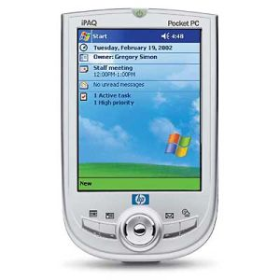
Portable computers (laptop) and PDA

Slide 27
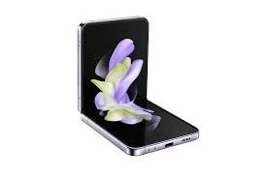
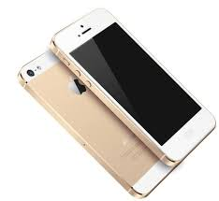
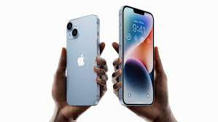
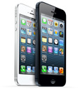
iPhone (and not only)!

Slide 28
John von Neumann legacy
Hardware
Software
Operating systems (are offering the operating medium for applications – used by these to access the computer’s resources)
Are specific to the platform designed for
Applications (text processors, database programs, web browsers, etc.)

Slide 29
I/O, processing, storage
Input
Processing
Output
Information storage
Input
Processing
Output
Memory

Slide 30
Flynn’s taxonomy – parallel calculus
SISD -Single Instruction (Stream), Single Data (Stream)
All von Neumann computers.
Ex. IBM 370, DEC VAX, SUN, IBM PC, MacIntosh.
SIMD - Single Instruction (Stream), Multiple Data (Stream)
One instruction flow applied on several data sets in parallel.
Ex. CRAY-1, DAP CM-1, WARP, CM-2, ILLIAC IV.
MISD - Multiple Instruction (Stream), Single Data (Stream)
More instructions operating to the same set of data
MIMD - Multiple Instruction (Stream), Multiple Data (Stream)
More independent CPU operating as parts of a bigger system. The majority of parallel processors are in this category.
Ex. Transputere, Supernode, DADO, N-cube, Ultracomputer, Butterfly, Alliant, Sequent Balance, CRAY X-MP.

Slide 31
SISD (Single Instruction, Single Data)
Input/Output
CU
I
PU
D
Memory

Slide 32
SIMD (Single Instruction, Multiple Data)
D₁
PU₁
M₁
MM
CU
I
D₂
PU₂
M₂
Obs. Like SPMD

Slide 33
SIMD Examples
SIMD (Single Instruction, Multiple Data) is a type of parallel processing architecture that allows a single instruction to perform the same operation on multiple data elements simultaneously. SIMD is commonly used in various computer systems, especially in multimedia and scientific applications where processing large amounts of data in parallel is beneficial. Here are some examples of computers and processors that use SIMD technology:
1. Intel SSE (Streaming SIMD Extensions):
- Intel introduced SSE as an extension to their x86 architecture. SSE provides a set of SIMD instructions for multimedia and data processing tasks.
- Example CPUs: Intel Pentium 4, Intel Core series (e.g., Core i7), and later Intel processors.
2. AMD SSE (Streaming SIMD Extensions):
- AMD processors also support SSE instructions, offering similar SIMD capabilities as Intel processors.
- Example CPUs: AMD Athlon 64, AMD Ryzen series.

Slide 34
SIMD Examples
3. ARM NEON:
- ARM's NEON technology is a SIMD architecture extension for ARM processors. It is often used in mobile devices, digital signal processing, and multimedia applications.
- Example CPUs: Various ARM-based processors used in smartphones and tablets.
4. NVIDIA GPUs (Graphics Processing Units):
- Graphics cards from NVIDIA, such as those in the GeForce and Quadro series, use SIMD processing to accelerate graphics rendering and scientific computing.
- Example GPUs: NVIDIA GeForce RTX 30 series, NVIDIA Quadro P series.
5. AMD Radeon GPUs:
- AMD Radeon graphics cards also employ SIMD architecture for parallel processing, benefiting gaming and compute workloads.
- Example GPUs: AMD Radeon RX 6000 series.

Slide 35
SIMD Examples
6. PlayStation and Xbox Consoles:
- Gaming consoles like the PlayStation and Xbox series utilize SIMD processors to enhance gaming graphics and performance.
- Example consoles: PlayStation 5 (uses AMD RDNA 2 architecture), Xbox Series X (uses AMD RDNA 2 architecture).
7. Intel Xeon Phi (formerly Knights Landing):
- Intel Xeon Phi is a family of high-performance processors designed for parallel computing and scientific simulations, making extensive use of SIMD technology.
SIMD technology plays a crucial role in optimizing performance for tasks that require repetitive operations on large datasets, such as multimedia processing, 3D graphics rendering, and scientific simulations.

Slide 36
MIMD (Multiple Instruction, Multiple Data)
MM
CU₁
I₁
PU₁
I
CU₂
I₂
PU₂
CU_{n}
I_{n}
PU_{n}

Slide 37
MIMD Examples
MIMD (Multiple Instruction, Multiple Data) is a parallel processing architecture that allows multiple processors or cores to execute different instructions on different sets of data independently. This type of architecture is commonly used in multi-core processors and distributed computing systems. Here are some examples of computers and systems that use MIMD architecture:
1. Intel Multi-Core Processors:
- Many Intel processors, such as those in the Intel Core i series and Intel Xeon series, employ MIMD architecture with multiple cores.
- Example CPUs: Intel Core i7, Intel Xeon E5, E7 series.
2. AMD Multi-Core Processors:
- AMD processors, including Ryzen and EPYC series, utilize MIMD architecture with multiple cores.
- Example CPUs: AMD Ryzen 7, AMD EPYC 7000 series.
3. NVIDIA CUDA:
- NVIDIA's CUDA architecture allows for MIMD parallel processing on their GPUs (Graphics Processing Units). This is widely used for scientific simulations and GPU computing.

Slide 38
MIMD Examples
4. Heterogeneous Computing Systems:
- Systems that combine CPUs and GPUs, such as NVIDIA's CUDA-enabled systems or AMD's heterogeneous systems, effectively use MIMD architecture for parallel processing tasks.
5. Distributed Computing Clusters:
- High-performance computing clusters often consist of multiple computers connected together to solve complex problems using MIMD architecture.
- Example systems: Beowulf clusters, Hadoop clusters.
6. Supercomputers:
- Supercomputers like IBM's Blue Gene series and Cray supercomputers use MIMD architecture to tackle large-scale scientific and engineering simulations.
7. Cloud Computing Instances:
- Many cloud computing providers offer virtual machines (VMs) and instances with multiple CPU cores, allowing users to harness MIMD parallelism for various workloads.

Slide 39
MIMD Examples
8. High-End Workstations:
- High-end workstations for tasks like 3D rendering, video editing, and scientific computing often feature multi-core processors, leveraging MIMD architecture.
9. Clusters for Scientific Research:
- Scientific research often requires MIMD processing for tasks like molecular modeling, weather simulations, and genome sequencing, using clusters of computers.
MIMD architecture is widely used in modern computing systems to improve performance and efficiency by dividing tasks among multiple processors or cores. Each processor or core can execute its own set of instructions on separate data, making it suitable for tasks that require a high degree of parallelism and concurrent processing.

Slide 40
MISD (Multiple Instruction, Single Data)
CU
CU
CU
I
I
I
MM
PU
PU
PU
D
D
D
D

Slide 41
MISD (Multiple Instruction, Single Data)
MISD (Multiple Instruction, Single Data) is a less common parallel processing architecture compared to SIMD and MIMD. In MISD, multiple processing units or cores execute different instructions on the same set of data. MISD architecture is rarely used in practical computing applications, and it's often considered more of a theoretical concept. As a result, there are limited real-world examples of MISD systems.
A hypothetical example to illustrate the concept may be one used for Fault-Tolerant Systems.
In some fault-tolerant computing systems, multiple redundant processing units may operate in a MISD fashion to enhance reliability. These systems aim to detect and correct errors that may occur during data processing. Here's how it might work:
Suppose you have a critical aerospace control system responsible for ensuring the safety of a spacecraft during a mission. This system is designed to process sensor data and make decisions based on that data.

Slide 42
MISD (Multiple Instruction, Single Data)
1. Triple Modular Redundancy (TMR): This is a common fault-tolerant technique. Three identical processing units (A, B, and C) are used. Each unit runs the same set of instructions, but they do so independently.
2. Single Data Source: All three processing units receive the same data from the sensors, representing a single set of data.
3. Comparison and Voting: After processing the data independently, the results from each processing unit are compared. If any unit produces a different result from the other two, a voting mechanism is used to determine the correct output. For example, if units A and B produce the same output, but unit C differs, the system will consider the result from A and B as correct.
4. Error Detection and Correction: If an error is detected in one of the processing units (e.g., unit C produces an incorrect result), the system can take corrective action. It may disable the faulty unit (C) and continue to operate using the results from the two correct units (A and B).

Slide 43
MISD (Multiple Instruction, Single Data)
In this hypothetical scenario, the MISD architecture is used to enhance fault tolerance. While it's not a conventional use of MISD, it demonstrates the concept of multiple instructions (processing units running independent code) acting on a single set of data (sensor inputs) to achieve reliability and fault tolerance.
It's important to note that MISD is not commonly found in typical computing applications. Most real-world parallel processing systems use SIMD (Single Instruction, Multiple Data) or MIMD (Multiple Instruction, Multiple Data) architectures because they are more practical and versatile for a wide range of tasks.

