Slide 1
IT Basics 6
An Introduction to Computers’ Logic
Răzvan Daniel Zota
Faculty of Cybernetics, Statistics and Economic Informatics
Bucharest University of Economic Studies
https://zota.ase.ro/itb

Slide 2
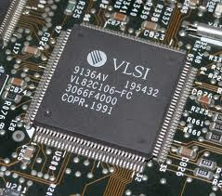
Computers’ Logic Basics – An Introduction
VLSI (Very Large Scale Integration)
It represents the manufacturing process of an IC (Integrated Circuit) by combining thousands and hundreds of thousands of logical gates (transistors) on a single silicon chip.
The microprocessor is a VLSI equipment
The beginnings of VLSI: ‘70

Slide 3
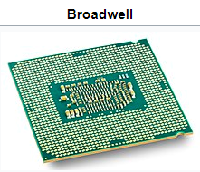
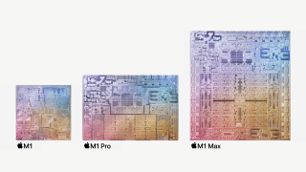
Computers’ Logic Basics – An Introduction
ULSI (Ultra Large Scale Integration) – chips with more than 1 million components
For example, one Intel® Xeon Core i7 E3 Broadwell has 3.2 billion transistors on a die of only 133 mm²
As of 2021, the maximum number of transistors in a commercial chip is found in Apple M1 Max, 57 billion !

Slide 4
Computers’ Logic Basics – An Introduction
In 2023 Apple is announcing M2 Pro and M2 Max processors with up to 67 billion transistors on a chip !
https://www.apple.com/ro/newsroom/2023/01/apple-unveils-m2-pro-and-m2-max-next-generation-chips-for-next-level-workflows/

Slide 5
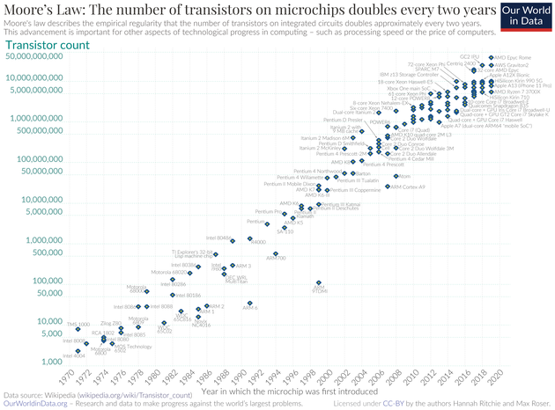
Gordon Moore’ Law

Slide 6
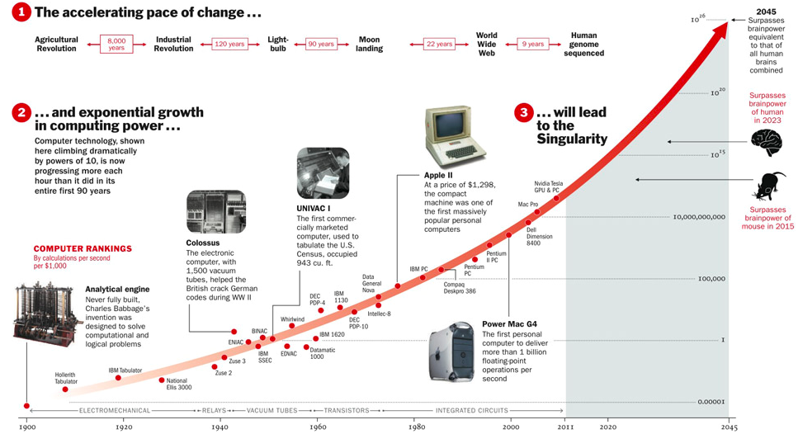
The exponential growth in computing power!
Source: http://content.time.com/time/interactive/0,31813,2048601,00.html

Slide 7
Introduction
Digital components
Digital electronics (+5V, -5V), (0V, -5V),
(0V, +5V)
0 and 1 can be represented by +5V and -5V, or 0V and -5V, or 0V and +5V

Slide 8
Introduction
Boole’s algebra
Basic operations:
Disjunction (OR)
Conjunction (AND)
Negation (NOT)

Slide 9
Truth tables – disjunction, conjunction, negation
p | q | p AND q
T | T | T
T | F | F
F | T | F
F | F | F
p | q | p OR q
T | T | T
T | F | T
F | T | T
F | F | F
p | q | p AND q
1 | 1 | 1
1 | 0 | 0
0 | 1 | 0
0 | 0 | 0
p | ~ p
1 | 0
0 | 1

Slide 10
Boole’s algebra – fundamental theorems
1. Identities and null elements:
There is element 0 (zero) as prime element with the properties: x∩0=0 and x∪0=x
There is element 1 (one) denoted last element with the properties: x∩1=x and x∪1=1
2. Uniqueness:
Element 1 is unique
Element 0 is unique
3. Complements - for every x in K there is a unique element x such that:
Notes:
---AND operation
∪ ----OR operation

Slide 11
Boole’s algebra – fundamental theorems (cont.)
4. Double negation theorem:
5. Absorption theorems:
x ∪(x ∩ y)=x
x ∩(x ∪ y)=x
6. De Morgan theorems:
Notes:
(ABC)' = A' + B' + C'

Slide 12
Boole’s algebra – fundamental theorems (cont.)
7. Idempotency:
x∪x∪…∪x = x
x∩x∩…∩x = x
8. Commutativity, associativity and distributivity:
x∪y = y ∪x
x ∪(y ∪z)=(x ∪y) ∪z
x ∪(y ∩ z)=(x ∪y) ∩ (x ∪z)
x ∩ y=y ∩ x
x ∩(y ∩z)=(x ∩ y) ∩z
x ∩(y ∪ z)=(x ∩y) ∪(x ∩z)

Slide 13
Boolean functions: existence and uniqueness

Slide 14
Primary definitions
We call an elementary product/elementary sum a product/sum of variables and/or their negations
We call disjunctive canonical form (DCF) of a logical relation, an equivalent relation (with the same truth value) which is a sum of elementary products constructed with the same variables as the initial relation, each product containing all variables (in normal or complementary form)

Slide 15
Primary definitions
We call conjunctive canonical form (CCF) of a logical function, an equivalent relation (with the same truth value) which is a product of elementary sums constructed with the same variables as the initial relation, each sum containing all the possible variables (in normal or complementary form)

Slide 16
DCF for one variable function
Let be
a boolean function with one variable and
a,b two boolean constants

Slide 17
CCF for one variable function

Slide 18
Proof of existence (DCF)

Slide 19
Proof of existence (CCF)

Slide 20
DCF for two variables function
Let be
A boolean function with two variables and a,b,c,d boolean constants

Slide 21
CCF for a function with two variables

Slide 22
Proof of existence for DCF

Slide 23
Proof of existence for CCF

Slide 24
Truth tables
We can associate any logic function with a truth table
0 | 0 | 1 | 0 | 1 | 0
0 | 1 | 0 | 0 | 0 | 1
1 | 0 | 0 | 0 | 0 | 1
1 | 1 | 0 | 1 | 1 | 0
Notes:
f(x,y)=xy’+yx’

Slide 25
Truth tables (cont.)
Reciprocally, if we have a truth table we may determine the logic function

Slide 26
Truth tables (cont.)

Slide 27
Truth tables (cont.)

Slide 28
Logical functions representation
Canonical forms:
Minterm form (DCF –disjunctive canonical form) – SUM of products – variables or their complements in a minterm are connected by boolean operation AND, and the minterms are connected by OR.
Maxterm form (CCF –conjunctive canonical form) – PRODUCT of sums – variables or their complements in a maxterm are connected by OR, and maxterms are connected by AND.
Another form of representation of a boolean function is the graphical one, using Venn diagrams

Slide 29
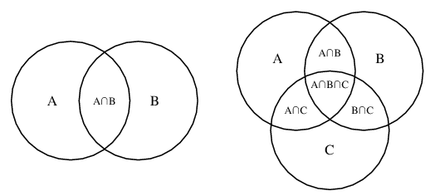
Venn diagram example
A Venn diagram is a schematic diagram used in logic theory to depict collections of sets and represent their relationships.

Slide 30
Minterms/maxterms for a function with two variables
Two variable function
x | y | Minterms m_{i} | Maxterms M_{i}
0 | 0
0 | 1
1 | 0
1 | 1

Slide 31
Minterms/maxterms for a function with three variables
Three variable function
x | y | z | Minterms m_{i} | Maxterms M_{i}
0 | 0 | 0
0 | 0 | 1
0 | 1 | 0
0 | 1 | 1
1 | 0 | 0
1 | 0 | 1
1 | 1 | 0
1 | 1 | 1

Slide 32
Minterms/maxterms - properties
Minterms are formed by the combination of the variables (or its’ complements) for which the function has the value of 1.
Maxterms are formed by the combination of the variables (or its’ complements) for which the function has the value of 0.

Slide 33
Minterms/maxterms - properties (cont.)
P1. The logic product between two terms m_{i} and m_{j} (i # j) of a logic function of n variables has the value of zero:
P2. The logic sum between two terms M_{i} and M_{j} (i # j) of a logic function of n variables has the value of 1:

Slide 34
Minterms/maxterms - properties (cont.)
P3. A logic function of n variables may be represented by a logic sum of minterms m_{i} (respectively, by a logic product of maxterms M_{i}):

Slide 35
Minterms/maxterms - properties (cont.)
P4. The complement of a logic function of n variables written in CCF may be expressed uniquely using the relation:

Slide 36
Minterms/maxterms - properties (cont.)
P5. If a logic function of n variables written in DCF is containing 2^{n} distinct terms of n variables then it is equal with 1.
In the same conditions, if the function is written in CCF, then it is equal with 0.

Slide 37
Minterms/maxterms - properties (cont.)
P6. Any minterm m_{i} of a logic function of n variables written in DCF is equal with the logic product of 2^{n}-1 M_{j} terms, respectively any maxterm M_{i} of a logic function of n variables written in CCF is equal with the logic sum of 2^{n}-1 m_{j} terms:

Slide 38
Logic functions of 2 variables
In the case of the 2 variable logic functions we may have the following canonical forms:
From here, it results 16 two-variable functions, in the minterm/maxterm formats, considering the 16 possible combinations for

Slide 39
2 variables logic functions
- INHIBITION | x inhibits y
or TRANSFER
- INHIBITION | y inhibits x
or TRANSFER
Exclusive OR | 1 if x<>y

Slide 40
2 variables logic functions (cont.)
| 1 if x=y

Slide 41
2 variables logic functions (cont.)
You may also check this website:
https://www.allaboutcircuits.com/technical-articles/16-boolean-logic-functions-of-2-input-system/

Slide 42
Logic function representation in DCF - example

