Slide 1
Logic Algebra 2
Logic Combinational Circuits

Slide 2
Contents
New types of logic gates
NAND and NOR gates
NAND and NOR circuits
2 level implementations
Multi-level implementations
XOR gate
Odd function
Parity generating/checkingXOR gate
Application: logic decoders

Slide 3
New logic gates
We may build any logic combinational circuit with the basic gates AND, OR and NOT
Also, in practice, there are used other logic gates

Slide 4
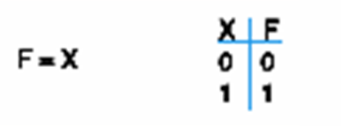
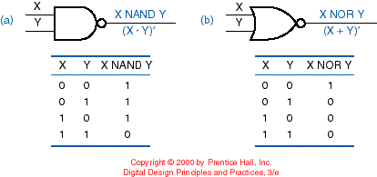
BUFFER, NAND and NOR functions

Slide 5
XOR and XNOR functions
X | Y | F = X⊕Y
0 | 0 | 0
0 | 1 | 1
1 | 0 | 1
1 | 1 | 0
XOR: “not-equal” gate
X
F
Y
X | Y | F = X⊕Y
0 | 0 | 1
0 | 1 | 0
1 | 0 | 0
1 | 1 | 1
XNOR: “equal” gate
X
F
Y

Slide 6
NAND Logic Gate
It is also known as the “universal gate” because any digital circuit may be implemented using only NAND gates.
To prove this, it is sufficient to show that AND, OR and NOT gates can be implemented using only NAND gates.

Slide 7
NAND Use
X
F = X
F = (X•X)
= X + X
= X
X
X
F = X•Y
X
F = ((X•Y) •(X•Y))
= (X•Y) + (X•Y)
= (X•Y) = (X + Y)
= X •Y
= X•Y
Y
Y
X
X
F = X+Y
Y
Y
F = (X • Y)
= X + Y
= X + Y

Slide 8
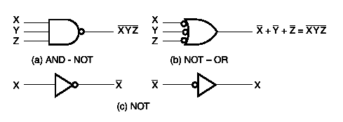
NAND Logic Circuits
To determine the NAND implementation we must follows these steps:
We find the sum-of-product form (DCF or DNF)
DNF is an AND-OR circuit
We transform the AND-OR circuit in a NAND circuit
We use the following alternating gates:

Slide 9
AND-OR Emulation Using NAND Gates
The initial for sum-of-products
NAND implementation

Slide 10
AND-OR Emulation Using NAND Gates
Checking:
G = WXY + YZ
G = ( (WXY)’ • (YZ)’ )’ = (WXY)’’ + (YZ)’’ = WXY + YZ

Slide 11
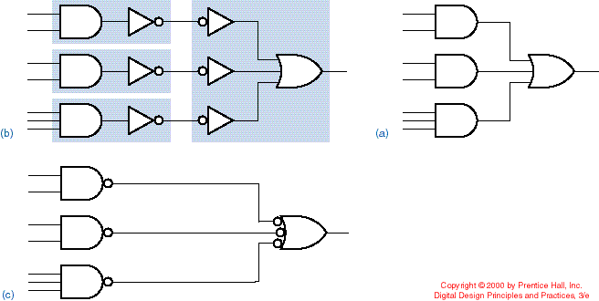
DNF using NAND gates
Initial DNF
Double negation and grouping
Replacing the gates with NAND gates
AND-NOT
NOT-OR

Slide 12
NAND Implementation - Example
F (X,Y,Z) = Σm(0,6)
DNF for F is the following: F = X’Y’Z’ + XYZ’
We get AND-OR implementation for F.
We transform AND-OR gates in NAND-NAND gates.

Slide 13
Example (cont.)
2 level implementation with NAND gates
F = X’Y’Z’ + XYZ’

Slide 14
Multiple level NAND circuits
The steps for transforming a multiple level circuit:
We are transforming all AND gates in NAND gates with AND-NOT symbols.
We are transforming all OR gates in NAND gates with NOT-OR symbols.
We are checking all the circles in the diagram. For every circle which is not negated by another circle on the same line, we insert a NOT gate or we complement the input.

Slide 15
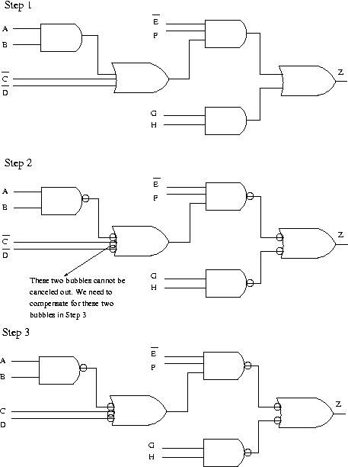
Example
Using NAND and NOT gates to implement the function: Z=E’F(AB+C’+D’)+GH
AB
AB+C’+D’
E’F(AB+C’+D’)
E’F(AB+C’+D’)+GH

Slide 16
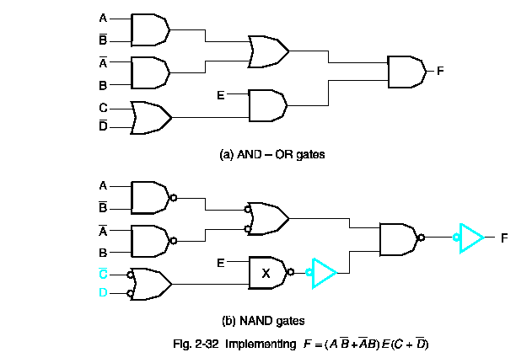
Another example

Slide 17
Practical use for NAND gates
In practice, the logical gates NAND and NOR are used as the building blocks for the flash memory cells. For example, the NOR memory is widely used in mobile phones and other small electronic devices.
NAND technology is used for building SSD (Solid State Drive) drives. Basically, two types of NAND cells exist: Single-level cell (SLC)-can store only one bit and Multi-level cell (MLC), that can store 4 possible values per cell. (There are also triple level cells and quad level cells that can store 8/16 values but they are not too much used).
In the last years, Samsung has developed the V-NAND technology that stacks over multiple layers of NAND cells (V comes from Vertical), generating larger storage capacity, much higher access speeds and approximately 10 times longer life duration.

Slide 18
NOR Gate
NOR gate – also an “universal gate” because we may implement any digital circuit using only NOR gates.

Slide 19
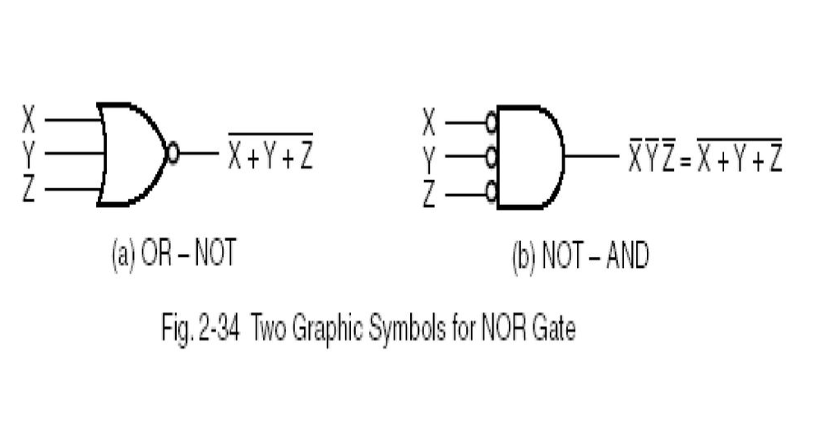
NOR Circuits
To get a NOR implementation for a logic function we have to:
Find the CNF form (product-of-sums)
CNF is a OR-AND circuit
Transform OR-AND in NOR circuits
We may use the following symbols:

Slide 20
2 level implementation - Example
F(X,Y,Z) = Σm(0,6)
In DNF F’ is:
F’ = Σm(1,2,3,4,5,7) = X’Y’Z + X’YZ’ + X’YZ + XY’Z’ + XY’Z + XYZ
F’ = XY’ + X’Y + Z
We are using the F’ complement to get F in CNF: F = (F’)' = (X'+Y)(X+Y')Z'
We get the OR-AND implementation for F.
We add circles and invertors to transform OR-AND implementation in a NOR-NOR implementation.

Slide 21
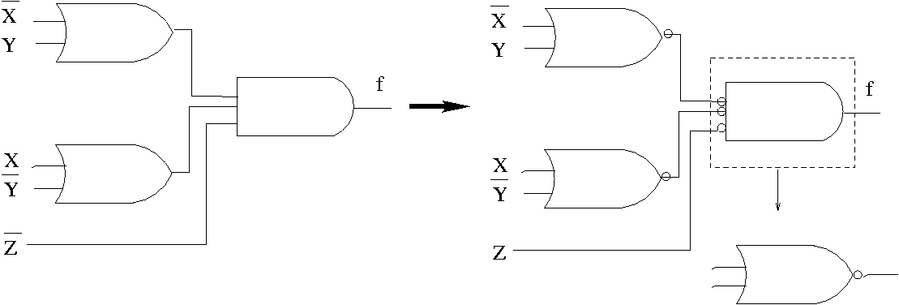
Example (cont.)
2 level implementation with NOR gates
F = (F’)' = (X'+Y)(X+Y')Z'

Slide 22
Multiple level NOR circuits
The steps for transforming a multiple level circuit:
We are transforming all OR gates in NOR gates with OR-NOT symbols.
We are transforming all OR gates in NOR gates with NOT-AND symbols.
We are checking all the circles in the diagram. For every circle which is not negated by another one on the same line, we are inserting a NOT gate or we complement the input.

Slide 23
OR-Exclusive (XOR)
XOR (denoted with ⊕) : “not-equal” function
XOR(X,Y) = X ⊕ Y = X’Y + XY’
Identities:
X ⊕ 0 = X
X ⊕ 1 = X’
X ⊕ X = 0
X ⊕ X’ = 1
Properties:
X ⊕ Y = Y ⊕ X
(X ⊕ Y) ⊕ W = X ⊕ ( Y ⊕ W)

Slide 24
XOR implementation
XOR(a,b) = ab’ + a’b
We are using 5 gates (directly):
2 invertors, 2 AND gates and one OR gate
2 invertors and 3 NAND gates
Indirectly:
4 NAND gates

Slide 25
XOR circuit with 4 NAND gates

Slide 26
NOR-Exclusive (XNOR)
XNOR: “Equality” function
XNOR(a,b) = ab + a’b’
We may see that: XNOR(a,b) = ( XOR(a,b) )’
( a ⊕ b )’ = ( a’b + ab’)’ = (a’b)’ •(ab’)’ = (a + b’) • (a’ +b) = ab + a’b’
a ⊕ b’ = ( a ⊕ b )’ = a’ ⊕ b

Slide 27
Odd function
x⊕y = x’y + xy’ = m₀₁ + m₁₀
x⊕y⊕z = xy’z’ + x’yz’ + x’y’z +xyz = m₁₀₀ + m₀₁₀ + m₀₀₁ + m₁₁₁
x⊕y⊕z⊕w = x’yzw + xy’zw + xyz’w + xyzw’ + x’y’z’w + x’yz’w’ + x’y’zw’ +xy’z’w’= m₀₁₁₁ + m₁₀₁₁ + m₁₁₀₁ + m₁₁₁₀ + m₀₀₀₁ + m₀₁₀₀ + m₀₀₁₀ + m₁₀₀₀
… ?
We notice that any XOR with n inputs has the value of 1 for all the minterms with all indexes that contain an odd numbers of 1 in their binary representation
The XOR function is also known as the “odd function”

Slide 28
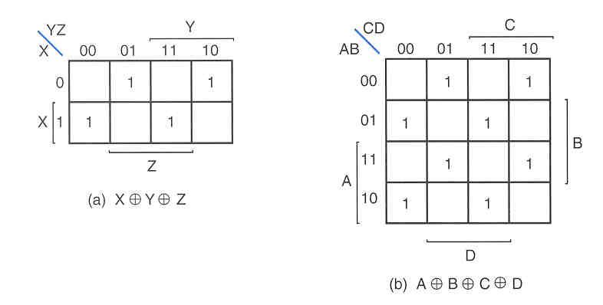
Odd function (cont.)
In the Karnaugh map the minterms are always at a distance of 2 from others (separated by a free cell)

Slide 29
Odd function (cont.)

Slide 30
Even function
How can we implement an even function?
By complementing XOR → XNOR

Slide 31
Parity generating and checking
Parity functions (odd and even) can be used to implement circuits for parity checking in the case of the error detection and correction codes.
We call a parity generator: a circuit which is generating a parity bit before transmitting the flow of bits.
We call a parity checker: a circuit which checks the parity when the message is received.
Notes:
10100101P
Even parity: P=0
Odd parity: P=1

Slide 32
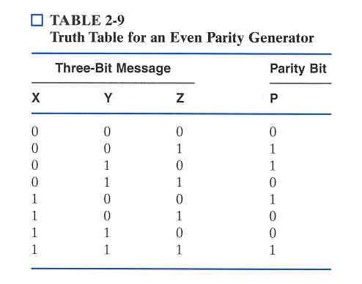
Parity generator - Example
P(X,Y,Z) must have the value of 1 for all input combinations which contain a odd number of 1’s.
As a result, our function will be XOR (odd function) with 3 inputs: P = X⊕Y⊕Z.

Slide 33
Parity checking - Example
How can we implement a parity checker for the previous example?
We may use a XOR circuit with 4 inputs (an odd function) Cor = X⊕Y⊕Z⊕P → 1 means transmission error
or
We may use a XNOR circuit with 4 inputs (an even function) Cor = (X⊕Y⊕Z⊕P)’ → 1 means correct reception of the message

Slide 34
Application – logic decoders
Logic decoders – essential for the control unit of the CPU and memories
Inputs
Outputs

Slide 35
Logic decoders (cont.)
A decoder is selecting only one output at a moment function of the input.
Example (the digital display):
a
a
a
a
a
f
b
f
b
f
b
f
b
f
b
g
g
g
g
g
e
c
e
c
e
c
e
c
e
c
d
d
d
d
d
a
a
a
a
a
f
b
f
b
f
b
f
b
f
b
g
g
g
g
g
e
c
e
c
e
c
e
c
e
c
d
d
d
d
d

Slide 36
Logic decoders (cont.)
Inputs |  |  |  | LEDs
x | y | z | t | a | b | c | d | e | f | g
0 | 0 | 0 | 0 | 1 | 1 | 1 | 1 | 1 | 1 | 0
0 | 0 | 0 | 1 | 0 | 1 | 1 | 0 | 0 | 0 | 0
0 | 0 | 1 | 0 | 1 | 1 | 0 | 1 | 1 | 0 | 1
0 | 0 | 1 | 1 | 1 | 1 | 1 | 1 | 0 | 0 | 1
0 | 1 | 0 | 0 | 0 | 1 | 1 | 0 | 0 | 1 | 1
0 | 1 | 0 | 1 | 1 | 0 | 1 | 1 | 0 | 1 | 1
0 | 1 | 1 | 0 | 0 | 0 | 1 | 1 | 1 | 1 | 1
0 | 1 | 1 | 1 | 1 | 1 | 1 | 0 | 0 | 0 | 0
1 | 0 | 0 | 0 | 1 | 1 | 1 | 1 | 1 | 1 | 1
1 | 0 | 0 | 1 | 1 | 1 | 1 | 1 | 0 | 1 | 1

Slide 37
Logic decoders (cont.)
a = x y z t + x y z t + x y z t
b = x y z t + x y z t
c = x y z t
d = x y z t + x y z t + x y z t
e = x y z t + x y z t + x y z t + x y z t
f = x y z t + x y z t + x y z t + x y z t
g = x y z t + x y z t + x y z t

