Slide 1
IT Basics The microprocessor and ASM
Prof. Răzvan Daniel Zota, Ph.D.
Bucharest University of Economic Studies
Faculty of Cybernetics, Statistics and Economic Informatics
zota@ase.ro
https://zota.ase.ro/itb

Slide 2
Contents
Basic microprocessor architecture
Intel microprocessor registers
Instructions – their components and format
Addressing modes (with examples)

Slide 3
Basic microprocessor architecture
CPU registers
Special memory locations on the microprocessor chip
Examples: accumulator, counter, FLAGS register
Arithmetic-Logic Unit (ALU)
The place where most of the operations are being made inside the CPU
Bus Interface Unit (BIU)
It controls data and address buses when the main memory is accessed (or data from the cache memory)
Control Unit and instruction set
The CPU has a fixed instruction set for working with (examples: MOV, CMP, JMP)

Slide 4
Instruction’s processing
Processing an instruction requires 3 basic steps:
Fetching the instruction from memory (fetch)
Instruction’s decoding (decode)
Instruction’s execution (execute) – implies memory access for the operands and storing the result
Operation mode of an “antique” Intel 8086
Fetch
1
Decode
1
Execute
1
Fetch
2
Decode
2
Execute
2
…...
Microprocessor
Busy
Idle
Busy
Busy
Idle
Busy
…...
Bus

Slide 5
Instruction’s processing
Modern microprocessors may process more instructions simultaneously (pipelining)
Operation of a pipeline microprocessor (from Intel 80486 to our days)
Fetch
1
Fetch
2
Fetch
3
Fetch
4
Store
1
Fetch
5
Fetch
6
Read
2
Fetch
7
Bus Unit
Decode
1
Decode
2
Decode
3
Decode
4
Idle
Decode
5
Decode
6
Idle
Instruction Unit
Execute
1
Execute
2
Execute
3
Execute
4
Idle
Execute
5
Execute
6
Execution Unit
Generate
Address
1
Generate
Address
2
Address Unit

Slide 6
X86 Basic System Architecture
A₁₉
A₀
Address Bus gives a memory address to the system and a I/O address to I/O system equipment
Data Bus transfers the data between the microprocessor, memory and I/O equipment attached
Control Bus is generating control signals derived from a I/O operation
Address Bus
8086
System
D₁₅
D₀
To memory
and I/O
Data Bus
(16 bit)
Control Bus
RD/WR
Memory
I/O

Slide 7
Data and memory address dimensions
Processor
8088
8086
80286
80386dx
80486
80586/Pentium (Pro)
Intel/AMD 64 bit
Data Bus
8
16
16
32
32
64
64
Address Bus
20
20
24
32
32
32
40
Maximum addressing memory
1,048,576 (1MB)
1,048,576 (1MB)
16,777,21 (16MB)
4,294,976,296 (4GB)
4,294,976,296 (4GB)
4,294,976,296 (4GB)
1,099,511,627,776 (1TB)
http://www.tomshardware.com/reviews/processor-cpu-apu-specifications-upgrade,3566-2.html

Slide 8
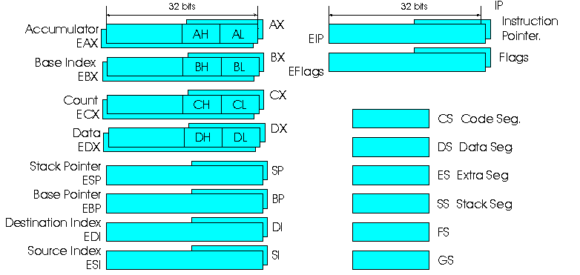
Microprocessor’s registers
Obs:
32 bit registers do not appear for 8086, 8088, 80286
Notes:
AX=1234h
AH=12h
AL=34h
CX=5673h
CL=73h
CH=56h

Slide 9
General purpose registers
32 biţi
AX
EAX
AH
AL
Accumulator
BX
EBX
BH
BL
Base Index
16 biţi
CX
ECX
CH
CL
Counter
DX
EDX
DH
DL
Data register
Obs:
32 bit registers do not appear for 8086, 8088, 80286

Slide 10
General purpose registers
16 biţi
SP
ESP
Stack pointer
BP
EBP
Base pointer
DI
EDI
Destination index
SI
ESI
Source index
Obs:
32 bit registers do not appear for 8086, 8088, 80286

Slide 11
General purpose registers
AX (accumulator) The AX register usually contains the result obtained from a arithmetic/logic operation (see also EAX, AH, or AL)
BX (base) The BX register usually contains the base address (offset) of the data in memory (see also EBX, BH, BL)
CX (count) The specialty of the CX register is counting. It plays the counter role for some specific instructions (see LOOP instruction).
DX (data) The DX register has some specific properties correlated with multiplying and dividing, such as:
It contains the most significant part of the result in case of multiplying two numbers on 16 or 32 bits;
It contains the most significant part of the divider before the division;
It contains the I/O port for some I/O instructions

Slide 12
Pointer and index registers
SP (stack pointer) The least “general”, used to address data in a memory region of LIFO (last-in, first-out) type: the stack. It is modified in the following cases:
As a result of PUSH and POP instructions;
A sub-routine CALL or a return (RET) from a sub-routine of a program;
Some system resources (the keyboard or internal clock) are using the stack when they interrupt the microprocessor.
BP (base pointer) Used to address a data array in the stack (it is referring to SS-stack segment)
SI (source index) – can be used to address indirectly data
DI (destination index) same as SI
IP (instruction pointer) It is always used to point to the next instruction to be execute by the microprocessor

Slide 13
The stack
Stack segment
Base of stack (initial value SP or ESP)
The POP instruction determines moving the top of the stack to a higher memory address
Local variables for the called procedure
The parameters of the called procedure
The PUSH instruction determines moving the top of the stack to a lower memory address
BP (EBP) register
Return Instruction Pointer
SP (ESP) register
Top of stack
The BP register it is set up to make a reference to the memory address for returning from the procedure
Notes:
16 bit - 2^16=64KB

Slide 14
Stack example
At the beginning:
BX
?
996
?
CX
?
998
?
1000
?
SP
1000
After MOV BX, 9 and PUSH BX:
BX
9
996
?
CX
?
998
9
1000
?
SP
998
After MOV CX, 10 and PUSH CX:
BX
9
996
10
CX
10
998
9
1000
?
SP
996

Slide 15
Stack example
After POP BX:
BX
10
996
?
CX
10
998
9
1000
?
SP
998
After POP CX:
BX
10
996
?
CX
9
998
?
1000
?
SP
1000

Slide 16
FLAGS register
FLAGS register
O
D
I
T
S
Z
A
P
C
O - Overflow Flag
D - Direction Flag
I - Interrupt Flag
T - Trap Flag
S - Sign Flag
Z - Zero Flag
A - Auxiliary Carry Flag
P - Parity Flag
C - Carry Flag
Notes:
FLAGS- 16 bit register
EFLAGS – 32 bit register

Slide 17
FLAGS register
A flag is a bit that identifies the current state of the microprocessor and its operating mode
The flags are being modified after the execution of some arithmetic or logic instructions
Examples:
C(carry) flag – it identifies the appearance of a binary carry bit in case of an addition or a borrow in case of a subtraction
O(overflow) flag – it is modified after an arithmetic operation. If it is set (of value 1) it means that the result doesn’t fit the destination operand
Z(zero) flag – it means that the result of an arithmetic or logic operation is zero
Notes:
Flag is set ⬄ flag=1
Flag is not set ⬄ flag=0
1+1=10
8 bits -2^8-1=255
250-250

Slide 18
FLAGS register
S(sign) flag – it shows the result of an arithmetic operation
D(direction) flag – when it is zero the processing of the elements is being made from the lower to the upper address and vice versa in the other case
I(interrupt) flag - it controls the possibility to respond to extern events (interrupt calls)
T(trap, trace) flag - used by the debugger programs, activating or not the possibility to execute the program step by step. If it is set, the CPU interrupts each instruction, leaving the debugger to execute the program step by step
Notes:
S=1-> negative
S=0->positive

Slide 19
FLAGS register
A(auxiliary carry) flag – it supports BCD operations.
P(parity) flag – it is set if the result of an operation contains an even number of 1 bits. If the number of 1s is odd, then PF=0.
Notes:
PF=1 result contains an even number of bits
00001110

Slide 20
Segment registers, IP and FLAGS
32 bits
IP
EIP
IP
Flags
EFlags
FLAGS
16 biţi
CS
Code segment register
DS
Data segment register
SS
Stack segment register
ES
Extra segment register
FS
Additional register (80386, 80486+)
GS
Additional register (80386, 80486+)
Notes:
1234:A412->12340+
A412
------------------------

Slide 21
Segment registers
CS(code) The code register contains the address for the start of the part of memory which contains the code of the program
DS(data) The data register contains the address for the beginning of the region of memory which contains data
ES(extra) Additional segment register
SS(stack) It defines the region of memory used by the stack.
The stack pointer register contains the address for the top of the stack
The BP register contains the address for the data inside the stack
FS and GS available beginning with 80386 and 80486 – additional registers used to access memory segments

Slide 22
Code machine language
The code machine language represents the native binary code which is “understood” by the microprocessor, containing instructions for its operation
From the assembler program the code machine is generated
The code machine instructions for 8086-80486 varies from 1 to 13 octets
There are over 20.000 variations of machine code
The real mode use 16 bits instructions
There are used 16 bits offset addresses and 16 bits registers
Notes:
1MB

Slide 23
Code machine language (cont.)
The protected mode may use instructions on 16 or 32 bits
The D bit from the descriptor it shows the way 80386/80486 instructions are using the registers and data from memory in the protected mode
D = 0 means 80386/80486 16 bits instructions
D = 1 means 80386/80486 32 bits instructions
The working mode with 32 bits instructions means that both offset addresses and registers are on 32 bits.

Slide 24
Addressing modes
Using registers – copy a byte or a word from the source register to the destination register
MOV BX, CX
Effective – copy an effective value (byte or word) from a memory location to a destination register
MOV AX, 3456h
Directly – copy a byte or a word from a memory location specified by a register
MOV AL, [1234h] (1234h represents the offset in the data segment)

Slide 25
Addressing modes(cont.)
Indirect by registers (indexed) – copy a byte or word from a memory location addressed by an index register (DI or SI) or a base register (BP or BX) in a register:
MOV AX, [BX]
Base plus index (relatively to the base indexed) - copy a byte or word from a memory location specified by a base register (BP or BX) plus an index register (DI or SI) in a register:
MOV DX, [BX + DI]

Slide 26
Addressing modes(cont.)
Register relative - copy a byte or word from a memory location addressed by an index register (DI or SI) or a base register (BP or BX) plus an offset to a register:
MOV AX, [BX + 1000h]
Base relative plus index (base relative indexed) – copy a byte or word from a memory location specified by a base register (BP or BX) plus an index register (DI or SI) plus an offset, into a register:
MOV AX, [BX + SI + 100h]

Slide 27
Instruction rules
Each instruction can access memory only once:
MOV var1,var2 is not a valid instruction
MOV AX,var2 followed by MOV var1,AX is correct.
For instructions with two operands their dimensions must be the same:
We may compare an 8 number with another 8 bit number
We may compare an 16 number with another 16 bit number
CMP AH,AX is not a valid instruction
The destination operand (normally, the left one) must identify a register or a memory location:
MOV 1234,AX is not valid
The Mode byte identifies what registers will be used by an instruction

Slide 28
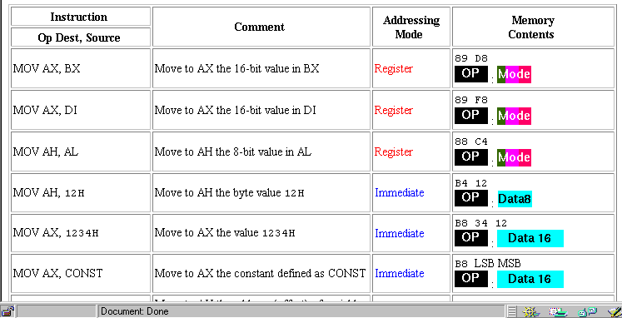
Addressing examples

Slide 29
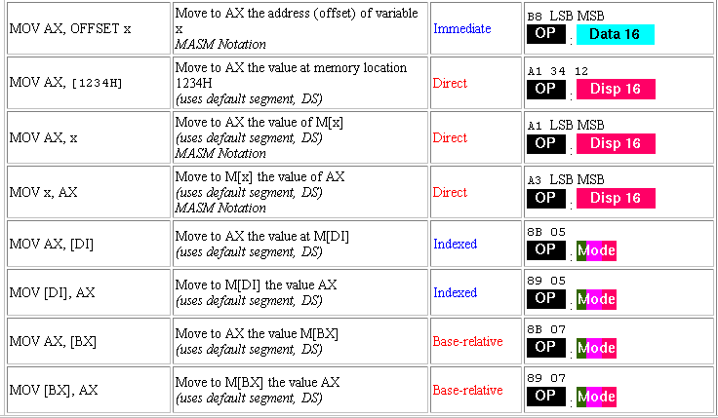
Addressing examples(cont.)

Slide 30
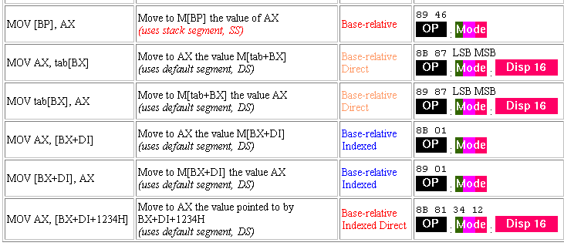
Addressing examples (cont.)

Slide 31
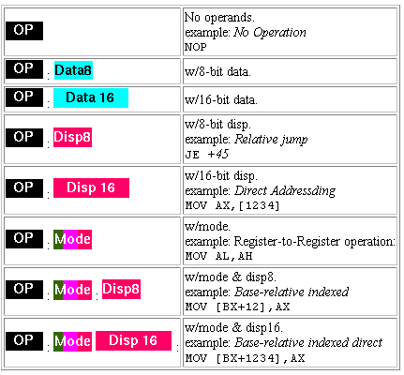
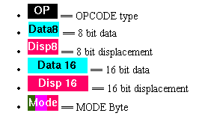
Instruction components and format
Opcode
Mode
Displacement
Data/
Effective value
Instruction’s components:

Slide 32
Instruction’s components
Opcode
Mode
Displacement
Data/
Effective value
The Opcode byte represents the operation code, the direction (D) and dimension (W)
Mode appears only for instructions that are using registers
The Mode byte represents the destination and source for the instructions with two operands
The destination and source are specified by the REG and R/M fields
D
W
OPCODE
MOD
REG
R/M

Slide 33
Opcode
Opcode (1 or 2 bytes) is selecting the operation (addition, subtraction, move, etc.) to be executed by the microprocessor
D (direction) – identifies the sense of the operation
D = 0 - from REG to R/M D = 1 - from R/M to REG
W – data’s dimension
W = 0 - byte
W = 1 – word or double word
D
W
OPCODE

Slide 34
Mode
Mode byte has 3 components
Mod specifies addressing type for the instruction with or without
offset
In the case when Mod field contains one of the values 00, 01 or 10, the R/M filed is selecting one of the addressing modes, such as:
MOV AL, [DI] (no displacement)
MOV AL, [DI + 2] (8 bits displacement)
MOD
REG
R/M
Mod Function
00 No displacement
01 8 bits displacement
10 16 bits displacement
11 R/M is a register

Slide 35
REG and R/M values
Code W = 0 (Byte) W = 1(Word) W =1 (Double Word)
000 AL AX EAX
001 CL CX ECX
010 DL DX EDX
011 BL BX EBX
100 AH SP ESP
101 CH BP EBP
110 DH SI ESI
111 BH DI EDI

Slide 36
Example
Let consider the instruction 8BECh on 2 bytes in binary (assume working on 16 bits)
Binary representation: 1000 1011 1110 1100 Results:
OPCODE: 100010 => MOV
D = W 1 => One word is copied in the register specified in the REG field
MOD 11 => R/M identifies the register
REG 101 => BP register
R/M 100 => SP register
In conclusion, the instruction to be executed is: MOV BP, SP

Slide 37
Example using R/M
In the case when Mod contains one of the values 00, 01 or 10, the R/M field has a new significance
Example:
1. If Mod = 00 and R/M = 101 the addressing mode is [DI]
2. If Mod = 01 or 10 and R/M = 101 the addressing mode is [DI + 33h] or [DI + 2222H], where 33h and 2222h are arbitrary values for the offsets
Code Function
000 DS:[BX+SI]
001 DS:[BX+DI]
010 SS:[BP+SI]
011 SS:[BP+DI]
100 DS:[SI]
101 DS:[DI]
110 SS:[BP]
111 DS:[BX]
Base plus
index
Indirect register

Slide 38
Example
Let have the instruction 8A15h in machine code
Binary representation is: 1000 1010 0001 0101
OPCODE: 100010 => MOV
D 1 => A word is copied to the register specified by the REG field
W 0 => Byte
MOD 00 => Memory without displacement
REG 010 => DL register
R/M 101 => Addressing mode [DI]
In conclusion, the instruction is: MOV DL, [DI]

